Slide 1
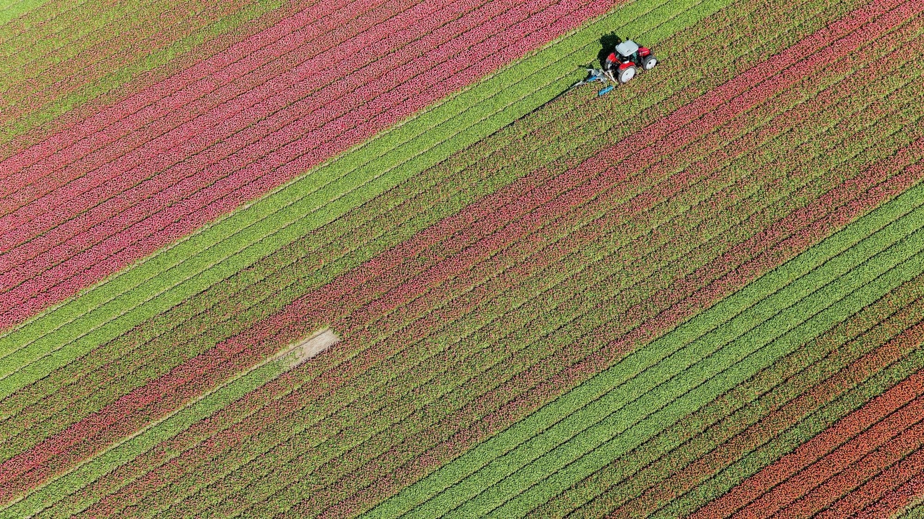
Workplace Module Project
Ryk du Plessis

Slide 2
Indian agriculture This presentation explores the design and implementation of a hybrid recommender system for anime titles, integrating collaborative filtering with content-based filtering to enhance the accuracy of user preference predictions
Table of Content
Introduction
Package Installation
Data Cleanup
Model Evaluation
Final Model Summary
Key Insights and Conclusion

Slide 3

Problem Statement: India’s agricultural sector is a cornerstone of the nation’s economy, yet managing its data remains a persistent challenge. Agricultural data is often complex, fragmented across regions, and difficult to access—hindering informed decision-making by farmers, policymakers, and researchers. This project seeks to create a data visualization platform that unifies agricultural data from states and districts across India. The platform will provide insights into crop production, yield statistics, and cultivated areas, helping users identify patterns, gaps, and regional disparities. By streamlining access to actionable information, the solution will empower farmers to make more informed crop choices, enable policymakers to design targeted interventions, and support researchers in analysing agricultural trends more effectively. Project Goal Build an interactive data visualization platform that consolidates agricultural data at state and district levels. Deliver actionable insights on crop production, yield performance, and cultivated land areas. Empower stakeholders to detect trends, identify gaps, and analyse regional disparities for informed decision-making. Impact Empower farmers with data-driven insights to make informed crop selection and optimize productivity. Enable policymakers to design and implement targeted interventions for sustainable agricultural development. Support researchers in conducting comprehensive analyses of agricultural trends and regional variations.

Slide 4
Comprehensive Toolkit of Packages Utilized
Tools and Their Roles:
Jupyter Notebook: Provides an interactive environment for coding, data exploration, and visualization.
Scikit-surprise: Specialized for building and evaluating recommender systems using explicit rating data.
SciPy: A Python library supporting scientific computations and advanced mathematical operations.
Matplotlib / Seaborn: Essential for creating diverse and insightful visualizations.
NumPy: Core library for numerical operations, enabling efficient handling of arrays and matrices.
Pandas: Key for data manipulation, including reading, cleaning, and analysing structured datasets.

Slide 5
Data Clean-up
Several preprocessing tasks were carried out to prepare the dataset for effective analysis
and visualization.
Data Preprocessing Steps:
Loading the Dataset: Imported the data into a data frame.
Initial Data Display: Previewed the first few rows for a quick overview.
Column Names: Verified and displayed column names.
Filtering Data: Selected specific subsets based on conditions.
Handled Missing Values: Addressed incomplete entries appropriately.
Removed Duplicates: Eliminated duplicate records.
Filling Missing Values: Replaced NaNs with column means.
Ensured Consistent Data Types: Standardized data types across columns

Slide 6
Purpose:
To develop predictive models that estimate crop production based on key variables
such as cultivated area and other relevant features.
These models aim to support yield forecasting and agricultural planning by providing
data-driven insights.
Evaluation Metrics:
Since the target variable—crop production—is continuous, the following regression metrics were used:
R² Score: Measures the proportion of variance in the target variable explained by the model. Higher values indicate better model performance.
RMSE (Root Mean Squared Error):Represents the average magnitude of prediction errors, expressed in the same units as the target variable (1000 tons). Lower values indicate more accurate predictions.
Model Comparison:
The Random Forest Regressor outperformed Linear Regression, achieving higher R² and lower RMSE, making it the preferred model for this task due to its ability to capture complex, non-linear relationships. Validation Techniques:

Slide 7
Purpose:
Train/Test Split - The dataset was split into 80% training and 20% testing to evaluate
model generalization on unseen data. Cross-Validation (Recommended) Implementing
K-Fold Cross-Validation is advised for more robust performance estimates, as it reduces
variance caused by a single data split.
Visualizations Residual Plots - Used to assess prediction errors and detect bias or variance in model performance.
Feature Importance Plot: Highlights the most influential predictors in the Random Forest model.(Include: Feature Importance Bar Plot and Residual Scatter Plots )Summary Random Forest demonstrates superior performance and greater robustness. Validation confirms that both models generalize well, but Random Forest provides more reliable predictions.
Future Improvements
Incorporate additional features such as rainfall, soil type, and weather patterns to enhance model accuracy.
Apply cross-validation consistently to improve reliability and reduce the risk of overfitting.

Slide 8
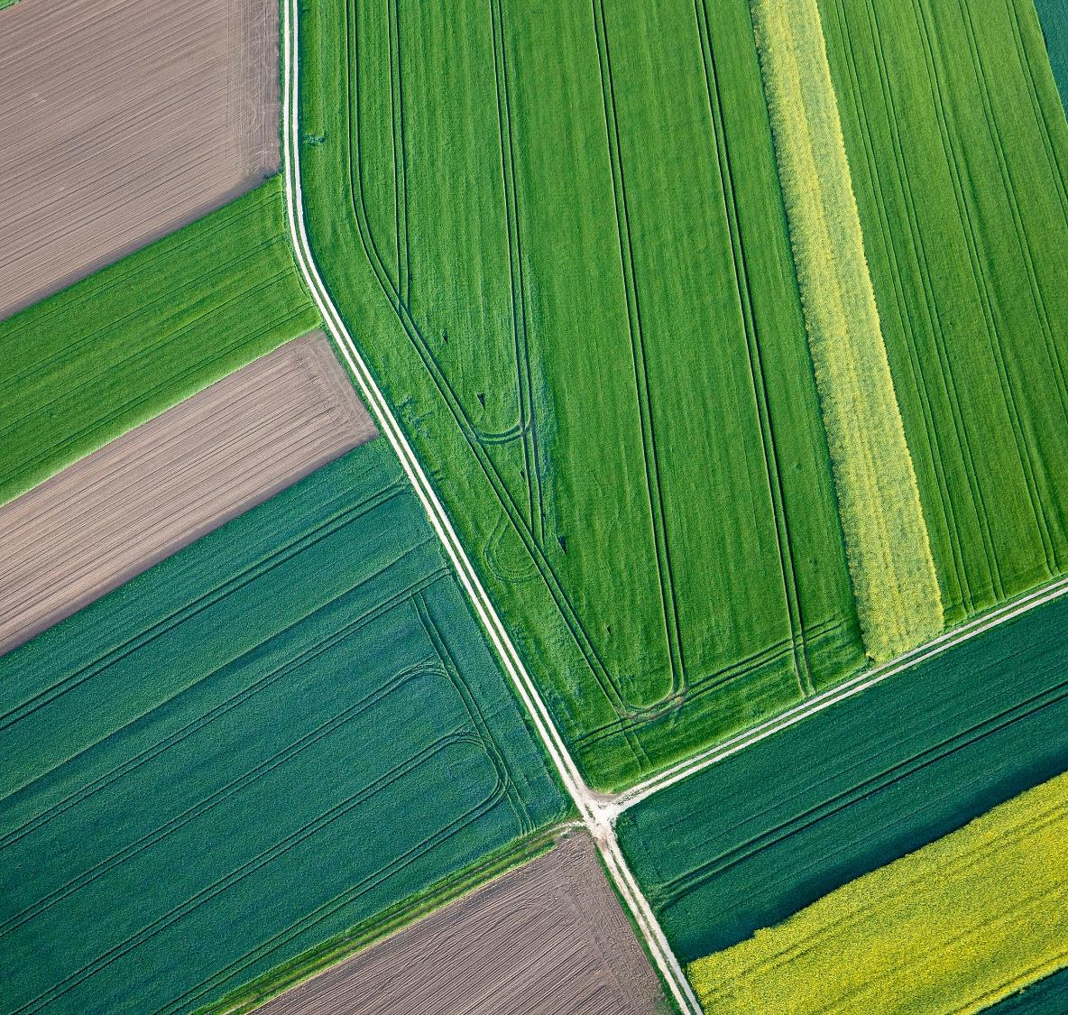
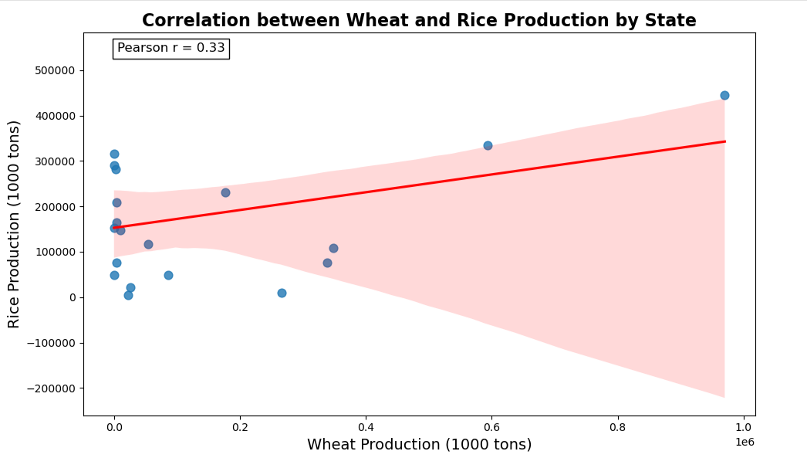
The Random Forest model effectively captures non-linear relationships and complex interactions among predictors.
Rice Area emerges as the most influential variable in predicting the outcome.
The residuals from the Random Forest model are more uniformly distributed, suggesting a better model fit compared to alternatives.

Slide 9
Final Model Code Snippet
Random Forest Overview:
Random Forest is an ensemble learning method that combines multiple decision
trees to improve prediction accuracy and reduce overfitting, particularly in regression
and classification tasks.
Model Implementation Steps:
Import the Random Forest model.
Instantiate the model with desired parameters.
Train the model on the training dataset.
Use the trained model to predict outcomes on the test dataset.
Application in Agriculture:
Random Forest is applied to predict agricultural yield by effectively capturing complex, non-linear relationships among input variables such as crop area, soil conditions, and climate factors.
Future Enhancements:
To further improve model performance:
Apply hyperparameter tuning for optimal settings.
Use cross-validation to ensure robust generalization.
Implement feature engineering to enhance predictive power.

Slide 10
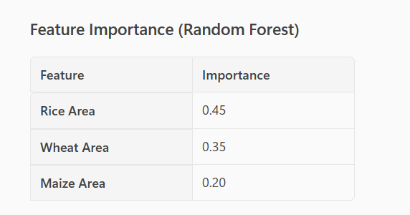

Final Model Summary
Feature Importance – Random Forest

Slide 11
Final Model Summary
Purpose of Residual Plot
Residual plots visualize the differences between actual and predicted values, helping assess the performance of a regression model.
Indication of Model Fit
Residuals evenly distributed around zero indicate no systematic bias and suggest a good fit for the Random Forest model.
Detecting Outliers and Issues
Residual plots highlight outliers and problematic patterns, guiding model refinement and improvement.
Importance of Model Monitoring
Regular monitoring of residuals ensures sustained model accuracy, especially when dealing with changing environments or new data.

Slide 12
Recommendations:
Focus on Rice Cultivation
Prioritize expanding rice cultivation areas, as this is the most influential factor for improving predictive accuracy.
Monitor Wheat and Maize
Continue monitoring wheat and maize areas closely, as they significantly contribute to yield predictions.
Utilize Random Forest Model
Maintain the use of the Random Forest model for its robustness and consistent residual distribution.
Explore Feature Engineering
Investigate feature engineering techniques to uncover new predictors or transform existing features for better generalization and performance.

Slide 13
Key Findings
Overview of Results
The Random Forest model demonstrated strong predictive performance, with residuals evenly distributed around zero—indicating minimal bias and good generalization. Feature importance analysis revealed Rice Area as the most influential predictor, followed by Wheat Area and Maize Area, emphasizing the critical role of crop-specific data in yield forecasting.
Key Learnings
Accurate measurement of Rice cultivation areas significantly impacts prediction accuracy. Wheat and Maize areas provide secondary but meaningful contributions. Random Forest’s robustness makes it well-suited for agricultural yield prediction tasks.
Current Constraints
Dataset lacks granularity in environmental factors. Limited temporal data restricts capturing seasonal variations. Model interpretability remains challenging compared to simpler algorithms.
Opportunities for Improvement
Data Enrichment: Add weather, soil, and irrigation data to improve prediction accuracy. Model Optimization: Perform hyperparameter tuning and explore advanced ensemble techniques. Feature Engineering: Create new derived features (e.g., crop rotation patterns) to enhance predictive power. Monitoring & Maintenance: Implement drift detection and schedule periodic retraining to maintain model performance. Scalability: Expand the approach to other crops and regions for broader applicability.

